Slide 1
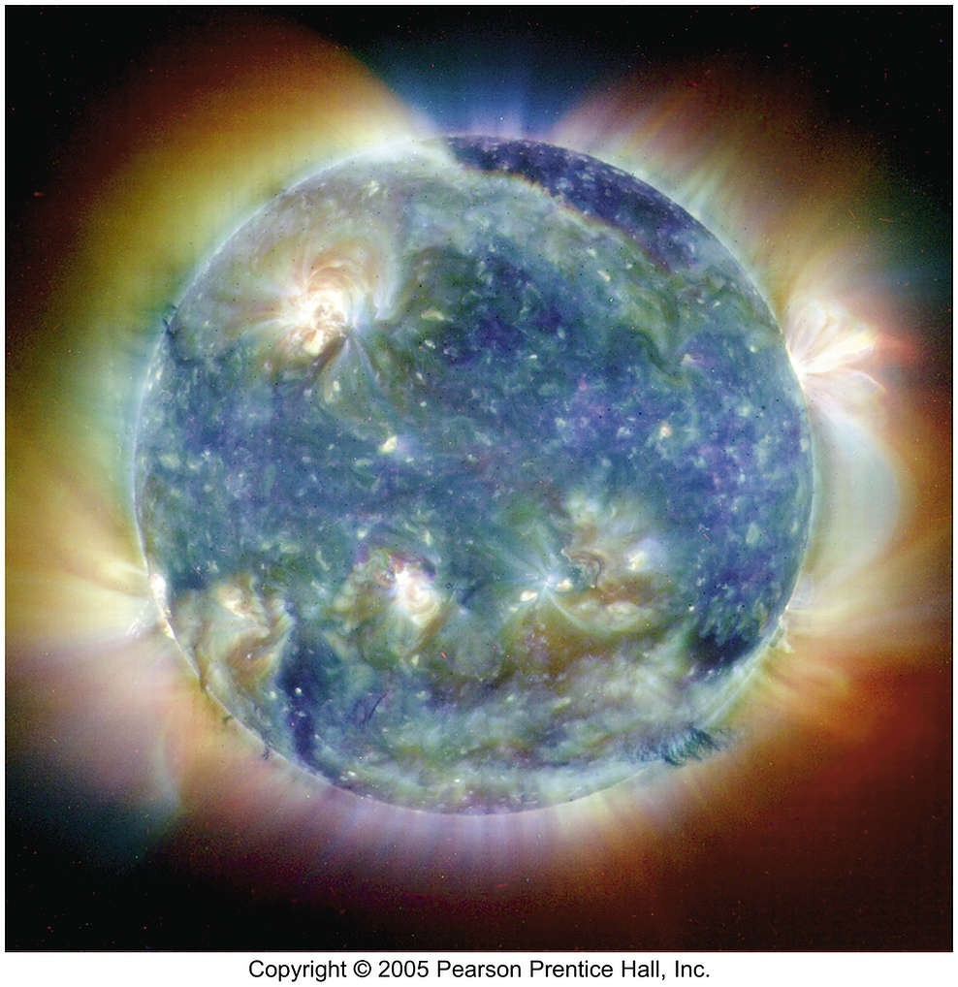
The Sun

Slide 2
The Sun: Our Parent Star

Slide 3
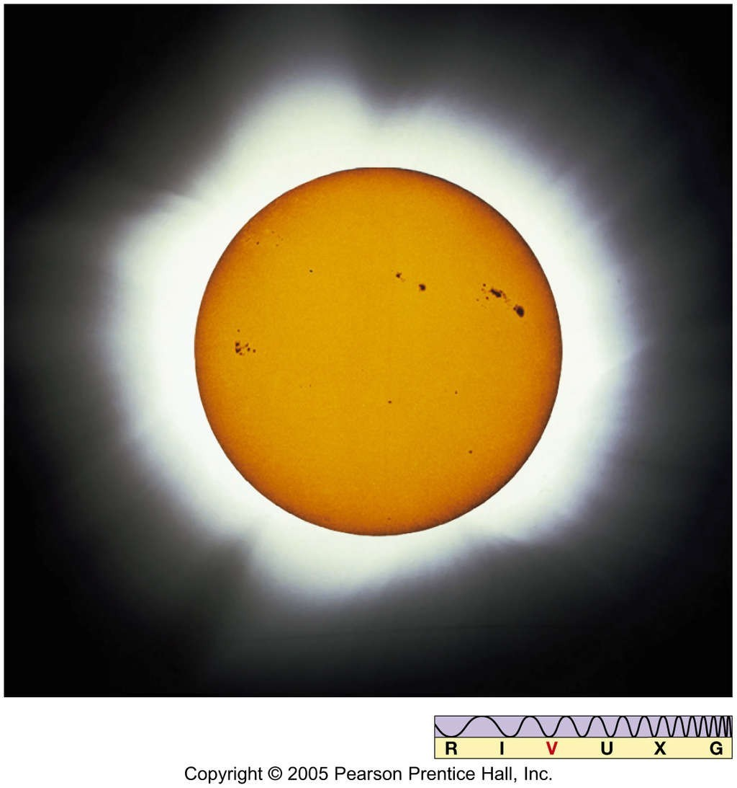
The Sun

Slide 4
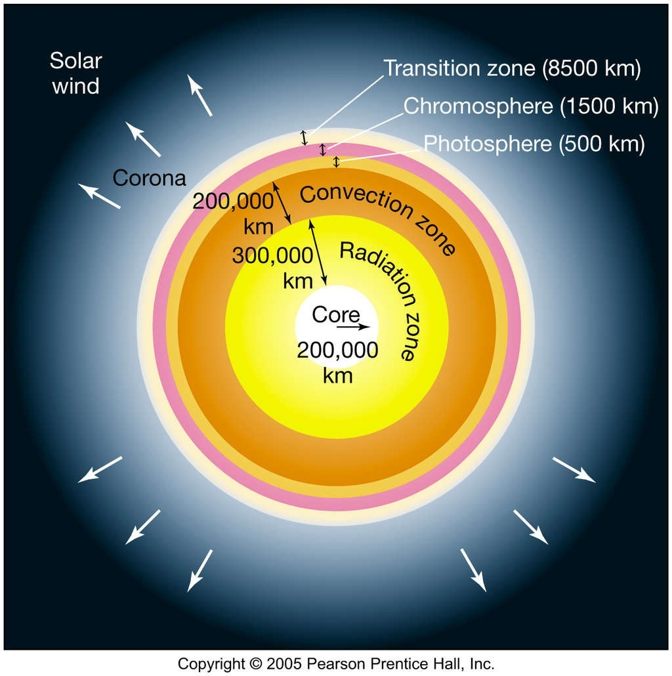
Physical Properties of the Sun
Interior structure of the Sun:
Outer layers are not to scale.
The core is where nuclear fusion takes place.

Slide 5
Physical Properties of the Sun
Luminosity – total energy radiated by the Sun – can be calculated from the fraction of that energy that reaches Earth.
Solar constant – amount of Sun's energy reaching Earth – is 1400 W/m².
Total luminosity is about 4 × 10²⁶ W – the equivalent of 10 billion 1-megaton nuclear bombs per second.

Slide 6
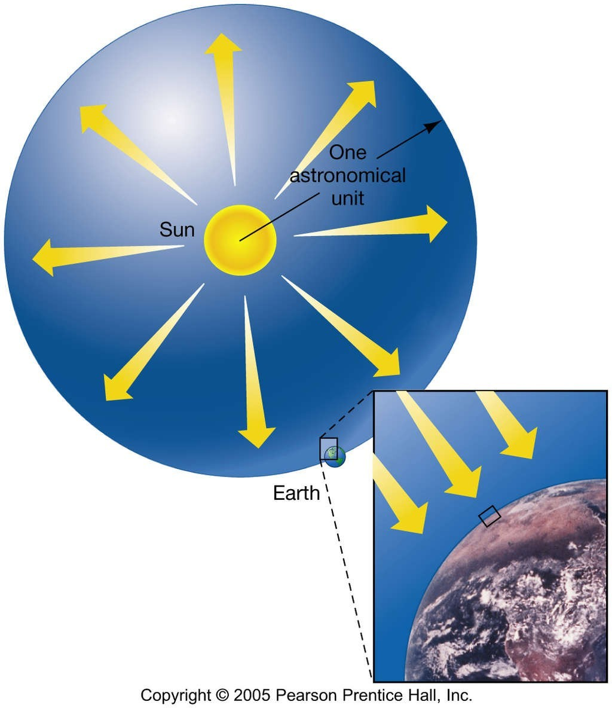
Physical Properties of the Sun
This diagram illustrates how one can extrapolate from the radiation hitting Earth to the entire output of the Sun.

Slide 7

The Heart of the Sun
Given the Sun’s mass and energy production, we find that, on the average, every kg of the sun produces about 0.2 milliwatts of energy.
This is not much – gerbils could do better – but it continues through the 10-billion-year lifetime of the Sun.
We find that the total lifetime energy output is about 3 × 10¹³ J/kg.
This is a lot, and it is produced steadily, not explosively. How?

Slide 8
The Heart of the Sun
Nuclear fusion is the energy source for the Sun. In general, nuclear fusion works like this:
nucleus 1 + nucleus 2 → nucleus 3 + energy
1
Ene3rgy! +
2

Slide 9
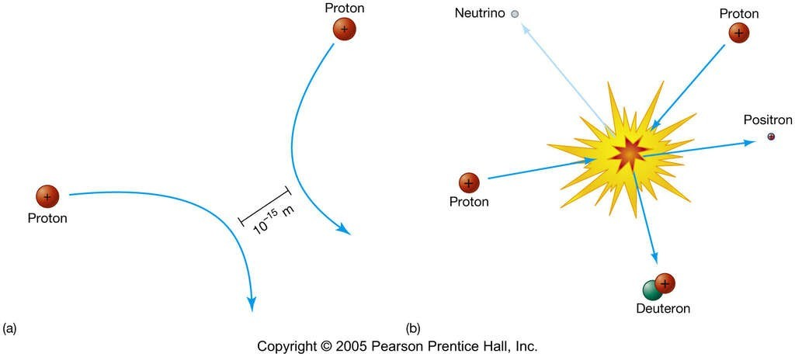
The Heart of the Sun
Nuclear fusion requires that like-charged nuclei get close enough to each other to fuse.
This can happen only if the temperature is extremely high – over 10 million K.

Slide 10
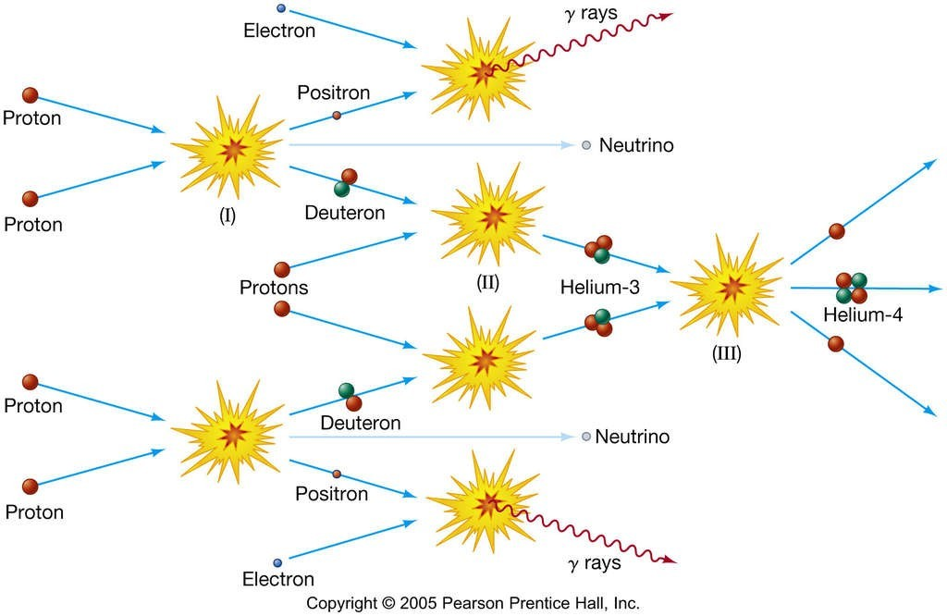
The Heart of the Sun This is the first step in a three-step fusion process that powers most stars.

Slide 11
The Heart of the Sun
The previous image depicts proton–proton fusion. In this reaction:
The helium stays in the core;
The energy is in the form of gamma rays, which gradually lose their energy as they travel out from the core, emerging as visible light;

Slide 12
But where does the energy come from?
It comes from the mass: if you add up the masses of the initial nuclei, you will find that it is more than the mass of the final nucleus.
Hydrogen mass:
1.00784 amu
x 4
4.03136 amu
4.00260 amu
0.02876 amu
Helium mass: Difference:

Slide 13
But where does the energy come from?
It comes from the mass: if you add up the masses of the initial nuclei, you will find that it is more than the mass of the final nucleus.
Hydrogen mass:
1.00784 amu
x 4
4.03136 amu
4.00260 amu
0.02876 amu
Helium mass: Difference:
H
H
He
+
Energy!
H
H

Slide 14
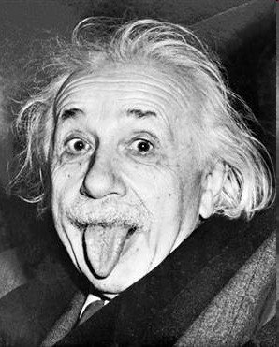
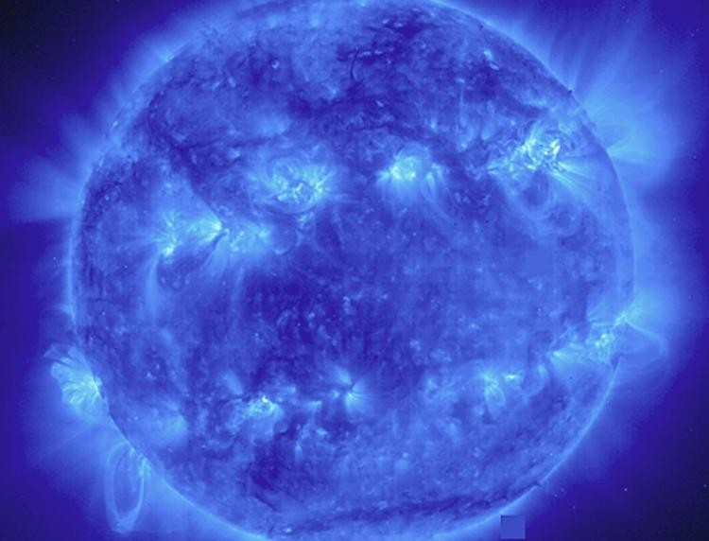
But where does the energy come from?
The relationship between mass and energy comes from Einstein’s famous equation:
E = mc²
In this equation, c is the speed of light, which is a very large number.
Bite me! It works!

Slide 15
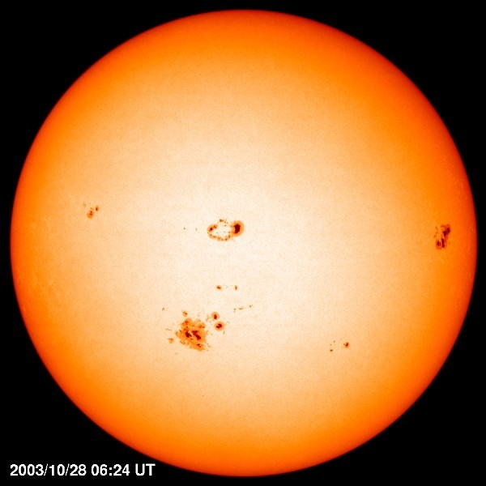
The Heart of the Sun
What this equation is telling us is that a small amount of mass is the equivalent of a large amount of energy – tapping into that energy is how the Sun keeps shining so long.
The Sun must convert 4.3 million tons of matter into energy every second.
The Sun has enough hydrogen left to continue fusion for about another 5 billion years.

Slide 16
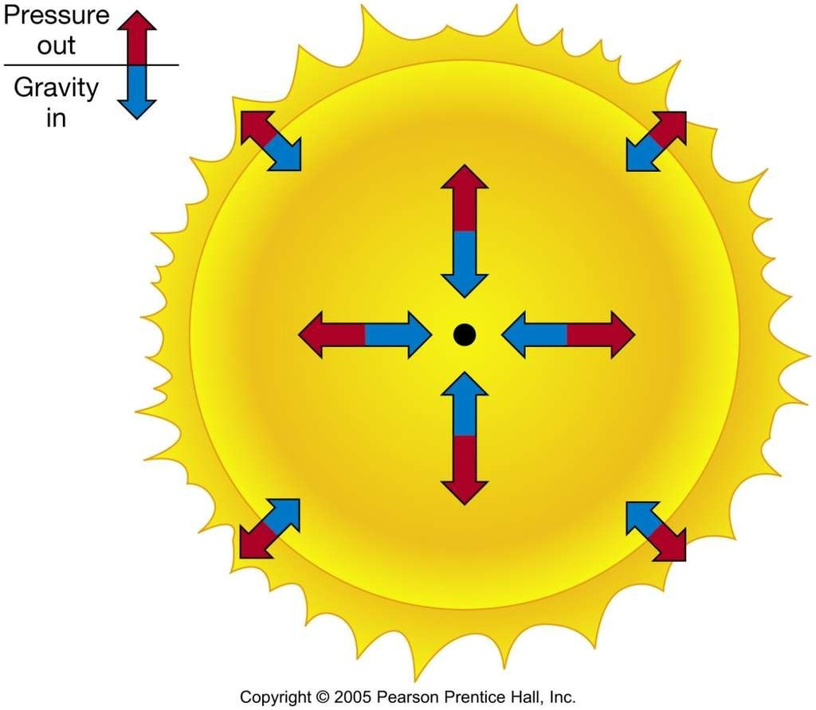
The Solar Interior
Mathematical models, consistent with observation and physical principles, provide information about the Sun’s interior.
In equilibrium, inward gravitational force must be balanced by outward pressure:

Slide 17
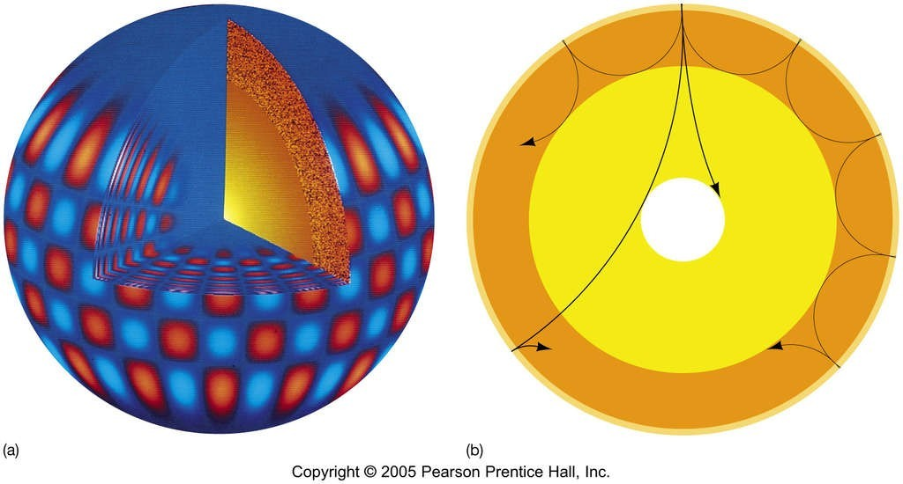
The Solar Interior
Doppler shifts of solar spectral lines indicate a complex pattern of vibrations:

Slide 18
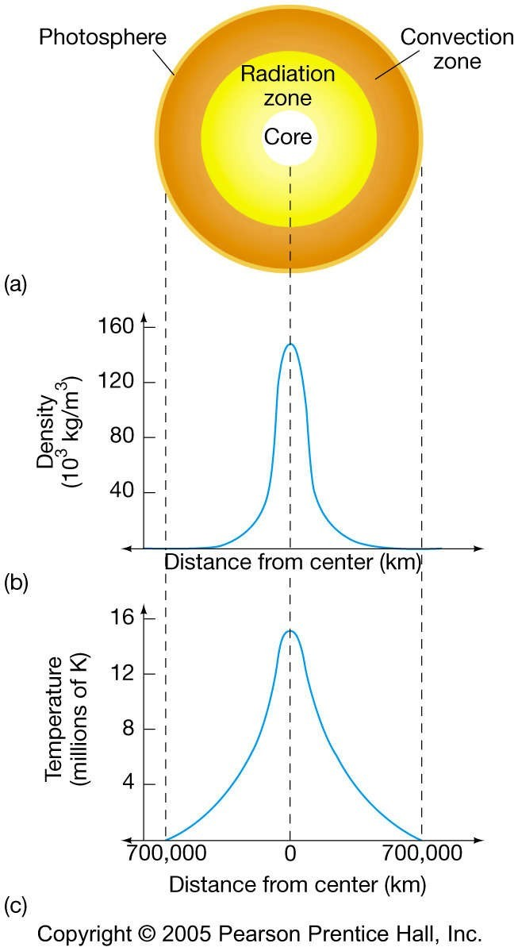
The Solar Interior
Solar density and temperature, according to the standard solar model:

Slide 19
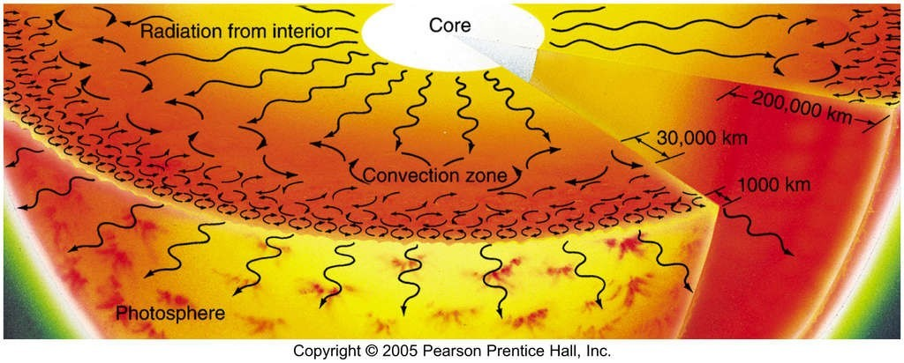
The Solar Interior
Energy transport
The radiation zone is relatively transparent; the cooler convection zone is opaque:

Slide 20
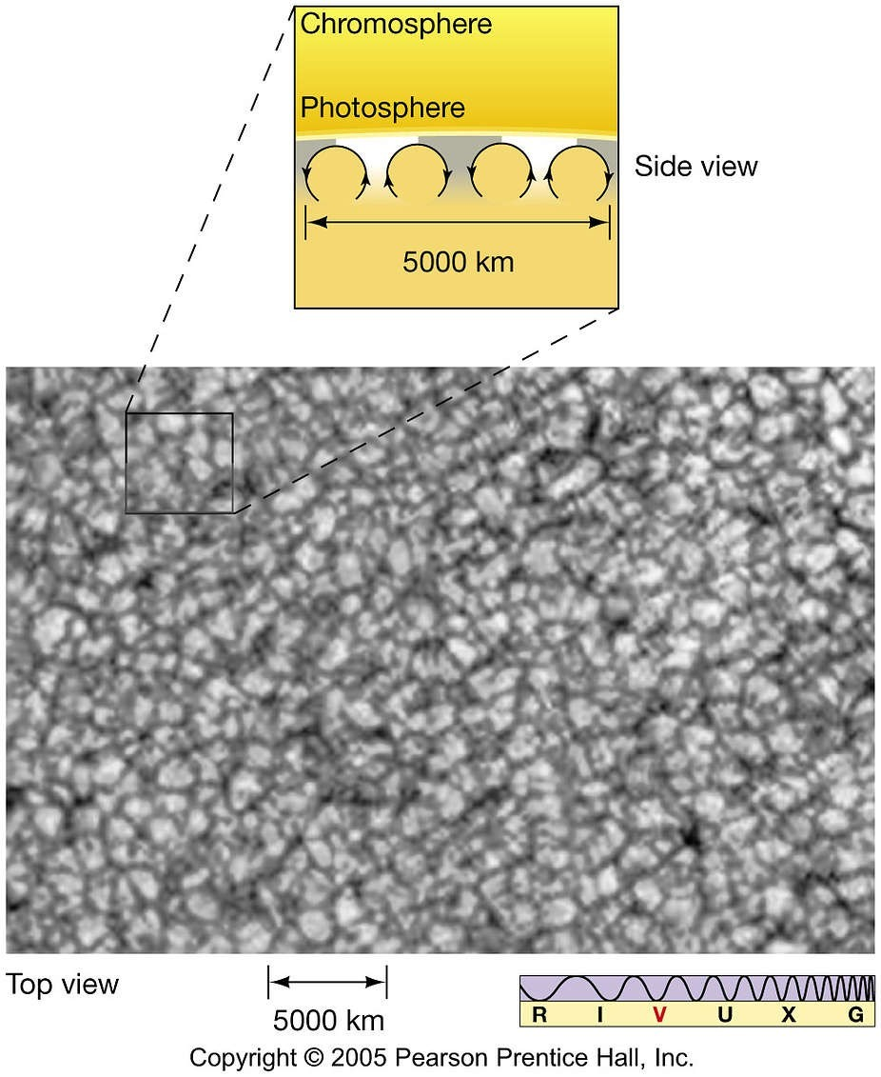
The Solar Interior
The visible top layer of the convection zone is granulated, with areas of upwelling material surrounded by areas of sinking material:

Slide 21
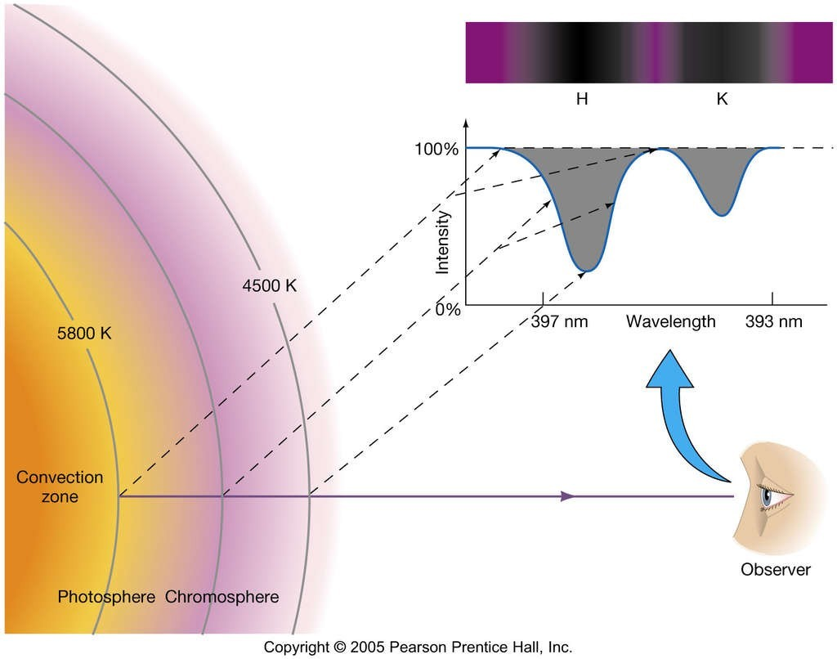
The Solar Atmosphere
Spectral analysis can tell us what elements are present, but only in the chromosphere and photosphere:

Slide 22
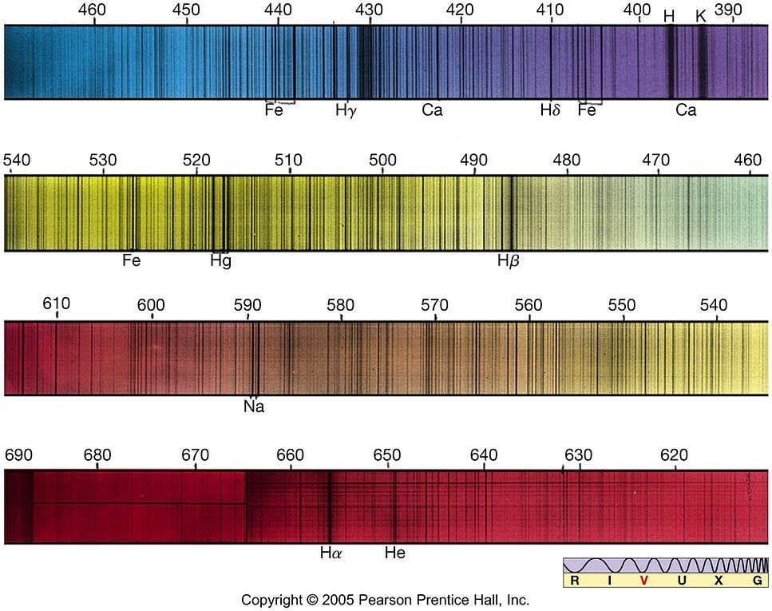
Solar Spectrum

Slide 23
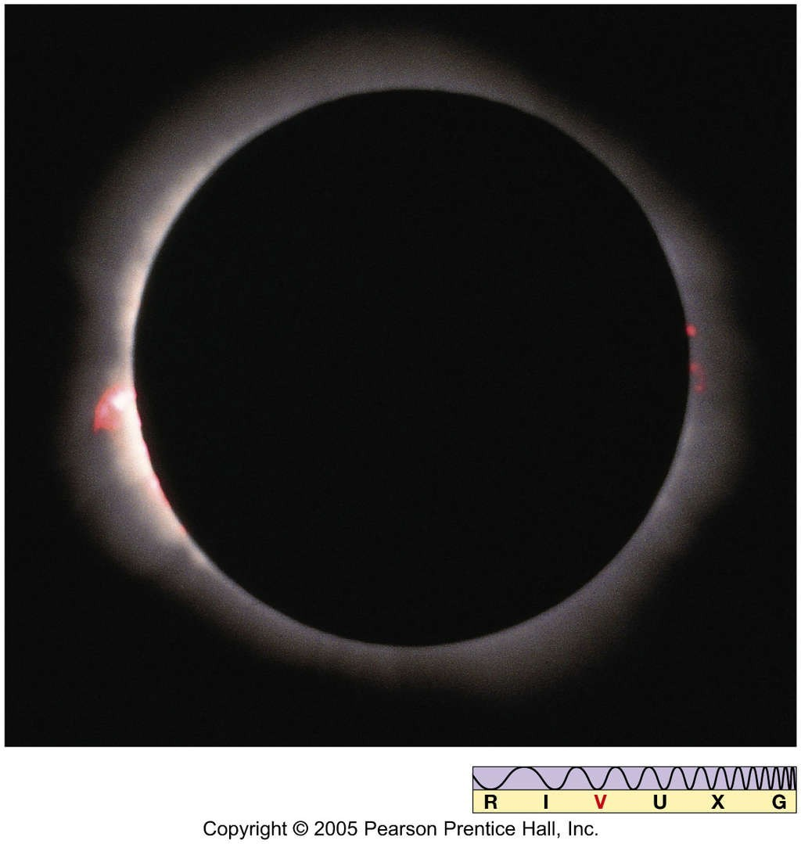
The Solar Atmosphere
The cooler chromosphere is above the photosphere
Difficult to see directly, as photosphere is too bright, unless Moon covers photosphere and not chromosphere during eclipse:

Slide 24
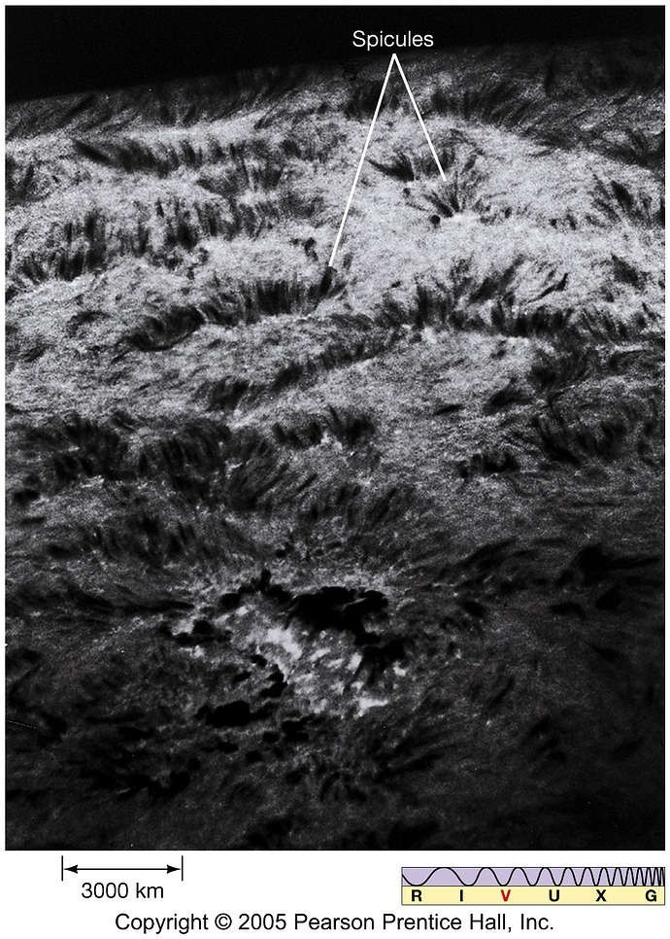
The Solar Atmosphere
Small solar storms in chromosphere emit spicules:

Slide 25
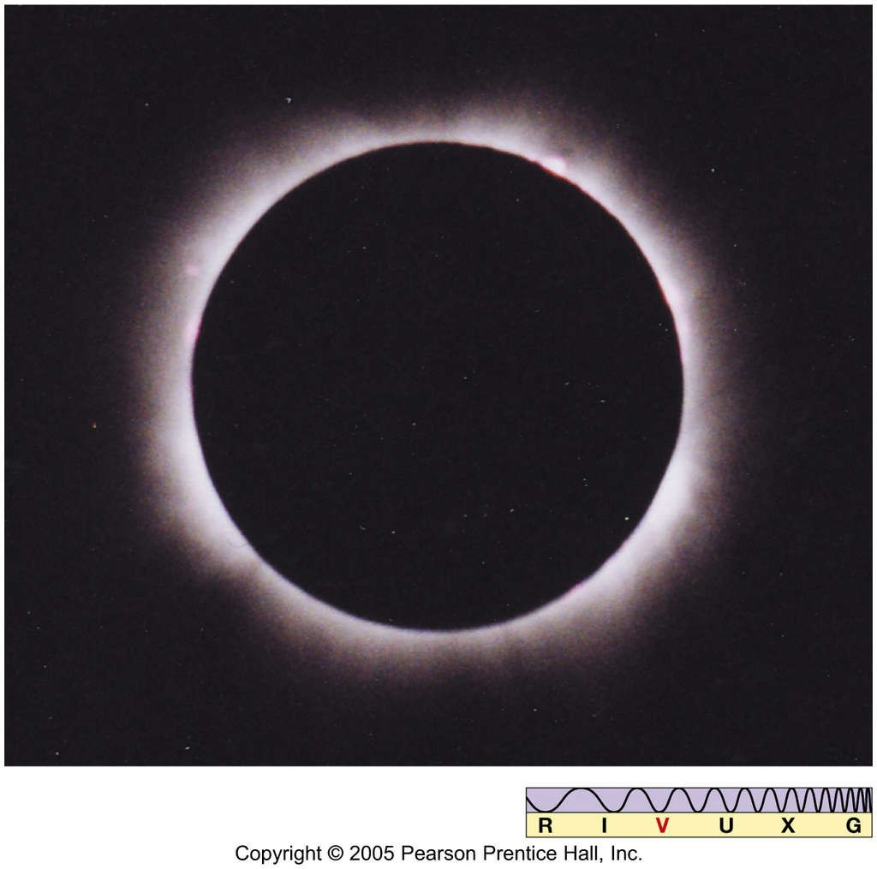
The Solar Atmosphere
Solar corona can be seen during eclipse if both photosphere and chromosphere are blocked:

Slide 26
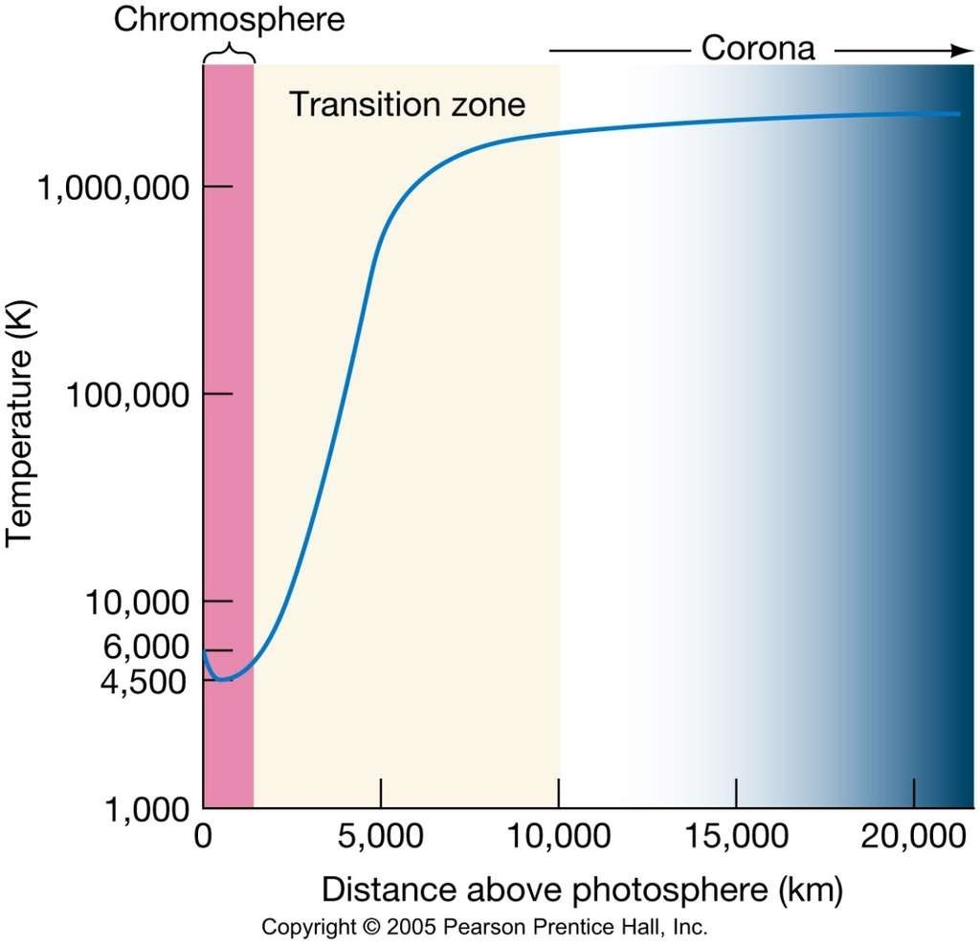
The Solar Atmosphere
Corona is much hotter than layers below it – must have a heat source, probably electromagnetic interactions.

Slide 27
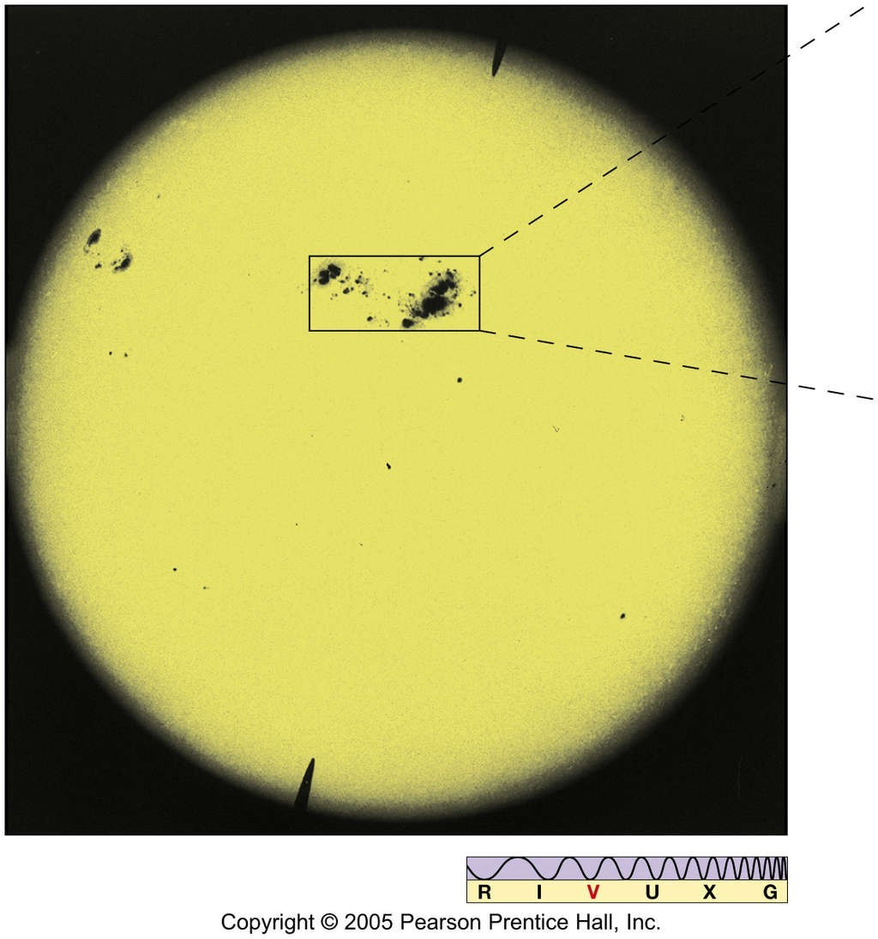
Sunspots

Slide 28
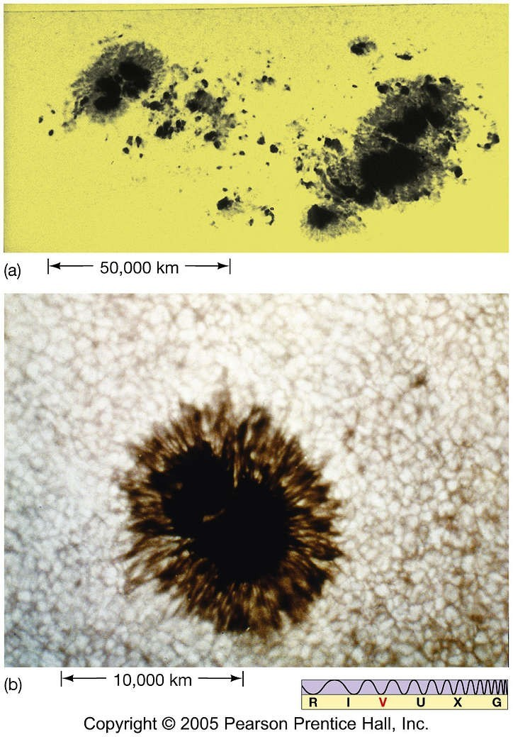
The Active Sun
Sunspots: appear dark because slightly cooler than surroundings:

Slide 29
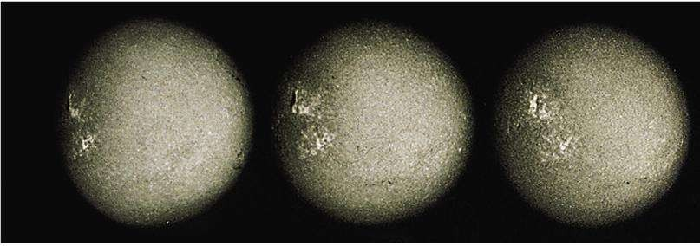
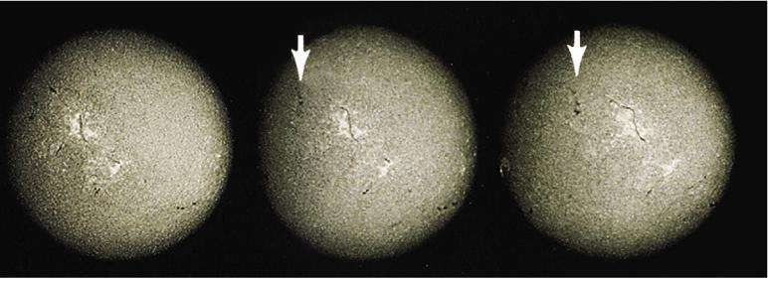
Sunspot Rotation

Slide 30
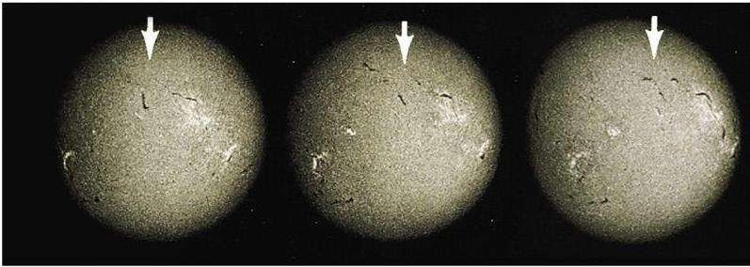
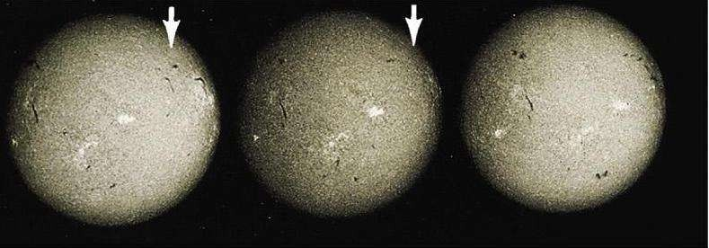
Sunspot Rotation

Slide 31
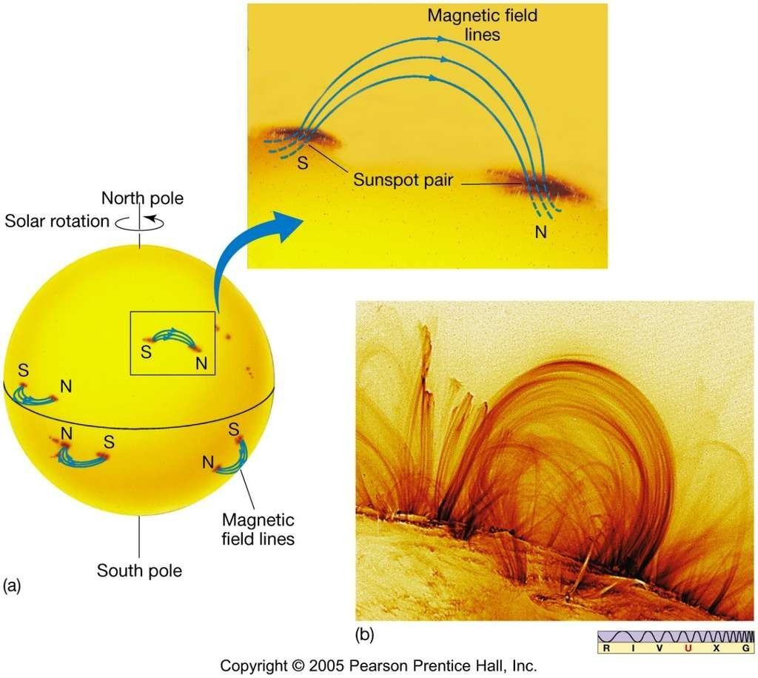
The Active Sun
Sunspots come and go, typically in a few days.
Sunspots are linked by pairs of magnetic field lines:

Slide 32
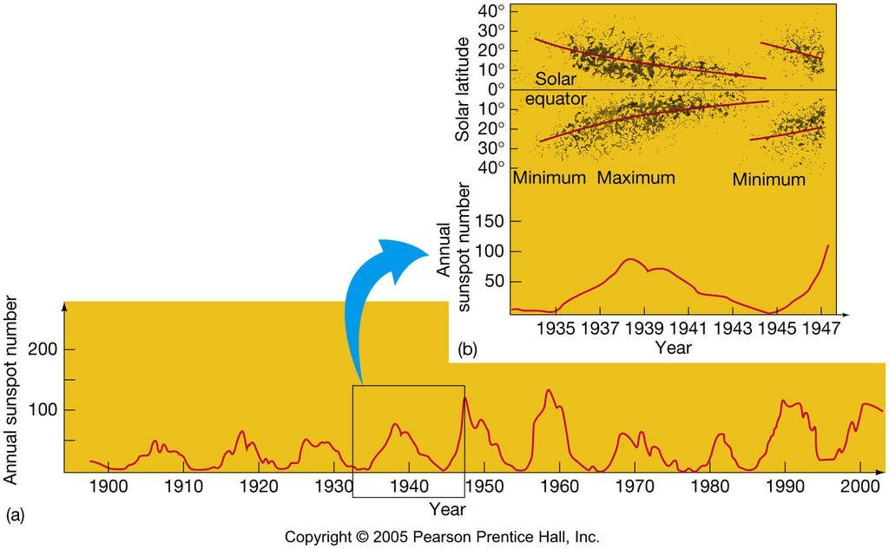
The Active Sun
The Sun has an 11-year sunspot cycle, during which sunspot numbers rise, fall, and then rise again:

Slide 33
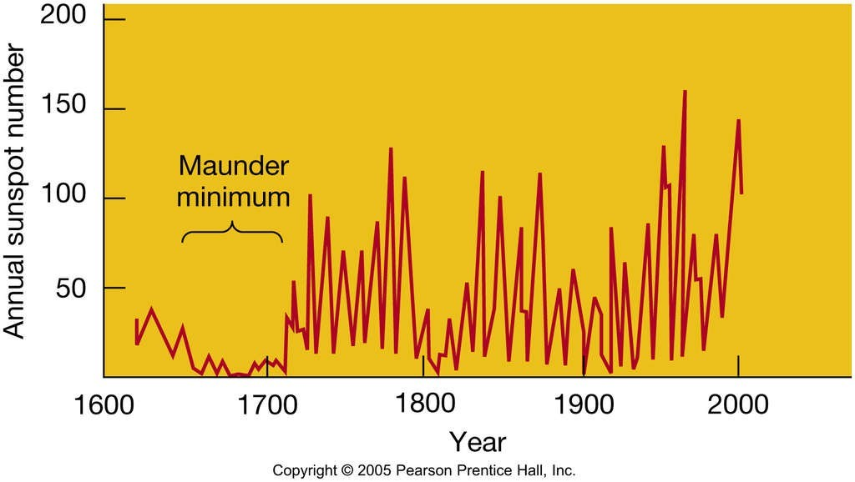
The Active Sun
This is really a 22-year cycle, because the spots switch polarities between the northern and southern hemispheres every 11 years.
Maunder minimum: few, if any, sunspots:

Slide 34
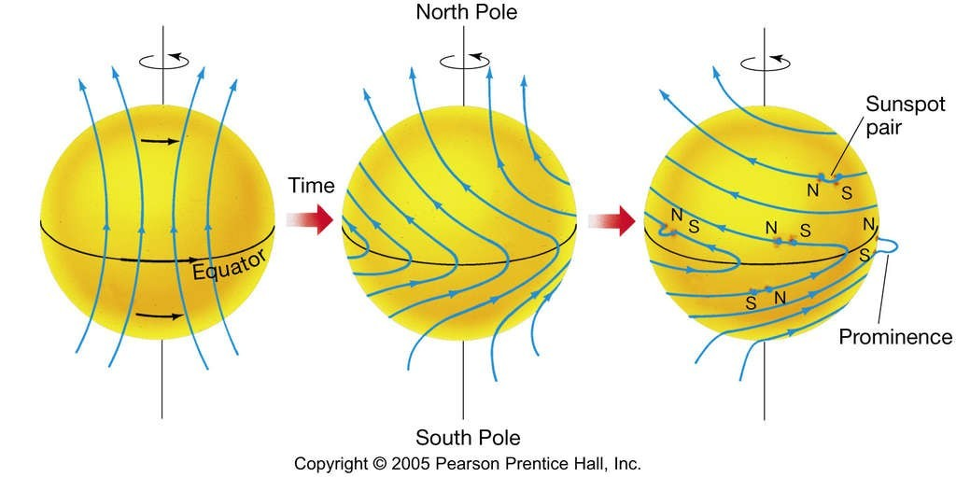
Solar Rotation

Slide 35
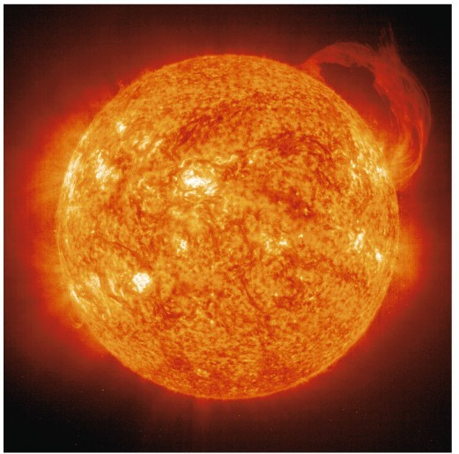
The Active Sun
Areas around sunspots are active; large eruptions may occur in photosphere.
Solar prominence is large sheet of ejected gas:

Slide 36
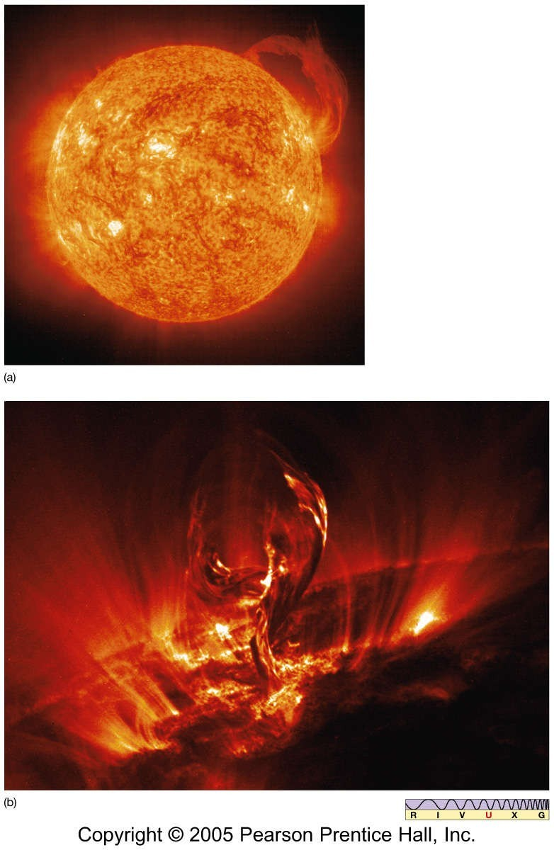
Solar Prominences

Slide 37
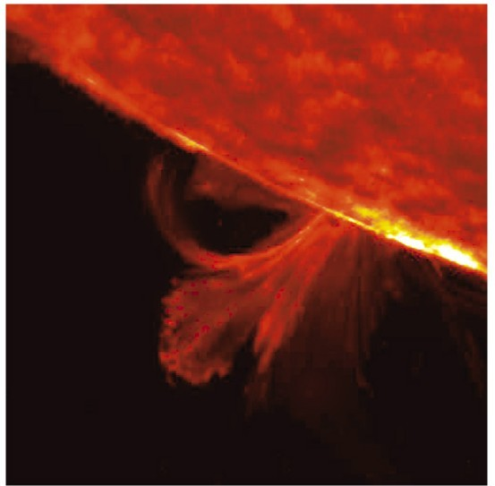
The Active Sun
Solar flare is a large explosion on Sun’s surface, emitting a similar amount of energy to a prominence, but in seconds or minutes rather than days or weeks:

Slide 38
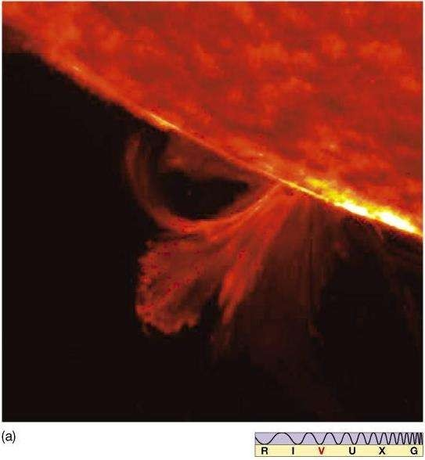
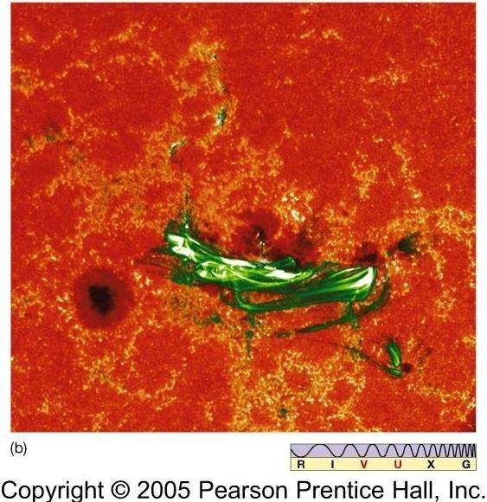
Solar Flares

Slide 39
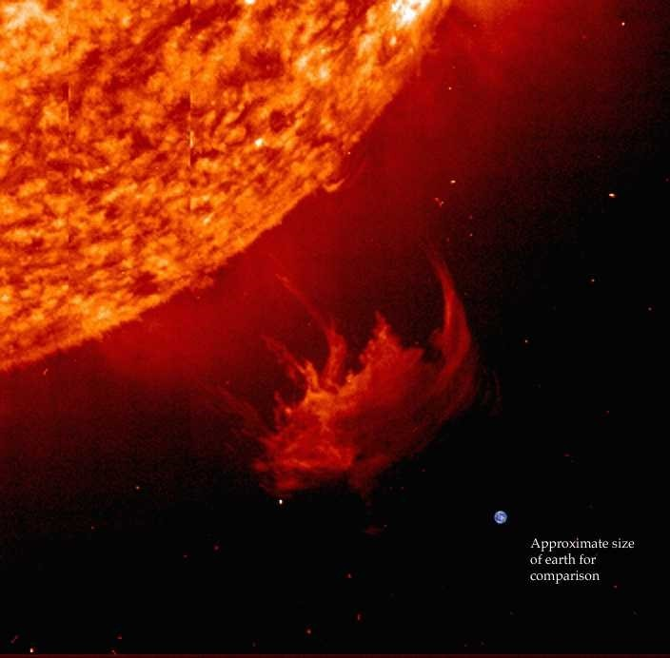
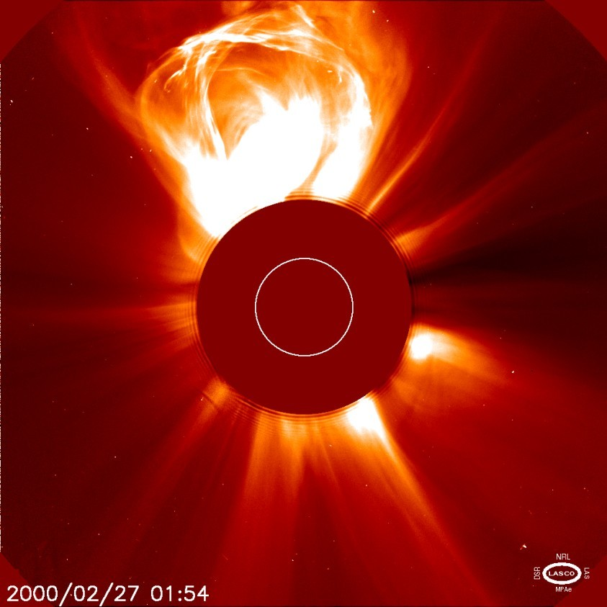
A coronal mass ejection (CME) is an ejection of material from the solar corona.
The ejected material is a plasma consisting primarily of electrons and protons in addition to small quantities of heavier elements such as helium, oxygen, and iron.
Coronal Mass Ejections
⦿
⦿

Slide 40
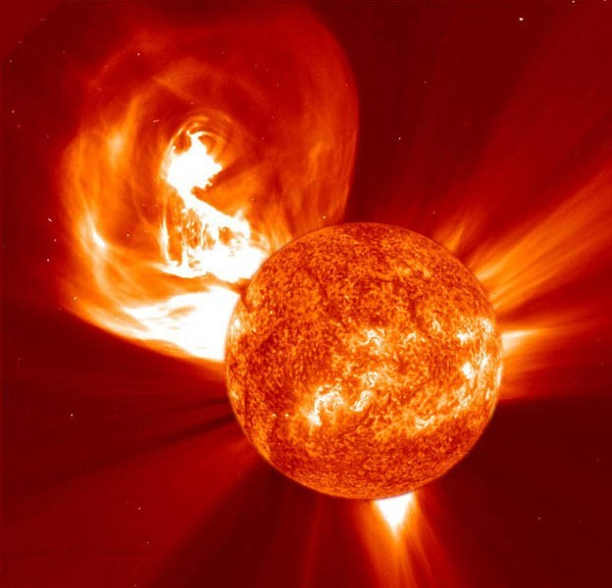
Coronal Mass Ejections
The more explosive CMEs generally begin when highly twisted magnetic field structures (flux ropes) contained in the Sun’s lower corona become too stressed and realign into a less tense configuration – a process called magnetic reconnection. This can result in the sudden release of electromagnetic energy in the form of a solar flare; which typically accompanies the explosive acceleration of plasma away from the Sun – the CME. These types of CMEs usually take place from areas of the Sun with localized fields of strong and stressed magnetic flux; such as active regions associated with sunspot groups.

Slide 41
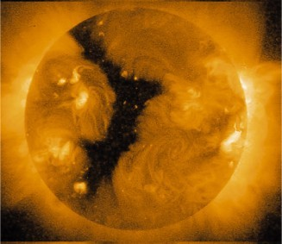
The Active Sun
Solar wind escapes Sun mostly through coronal holes, which can be seen in X-ray images:

Slide 42
A coronal hole is a temporary region of relatively cool, less dense plasma in the solar corona where the Sun's magnetic field extends into interplanetary space as an open field. Compared to the corona's usual closed magnetic field that arches between regions of opposite magnetic polarity, the open magnetic field of a coronal hole allows solar wind to escape into space at a much quicker rate. This results in decreased temperature and density of the plasma at the site of a coronal hole, as well as an increased speed in the average solar wind measured in interplanetary space.[2] If streams of high-speed solar wind from coronal holes encounter the Earth, they can cause major displays of aurorae.

Slide 43
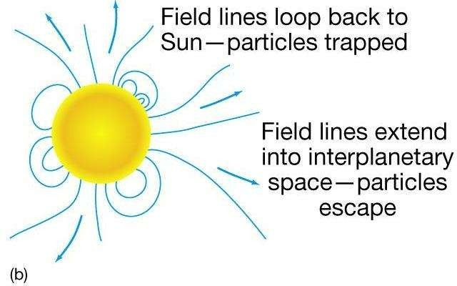
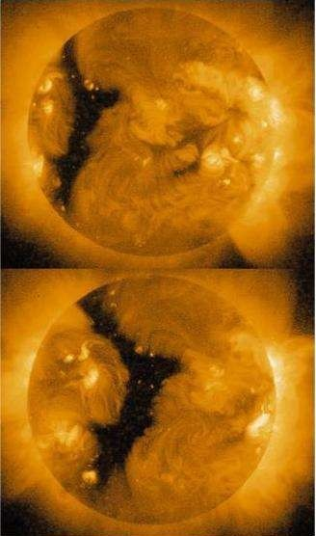
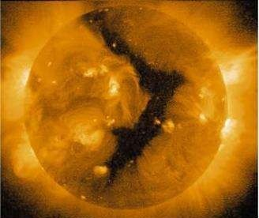
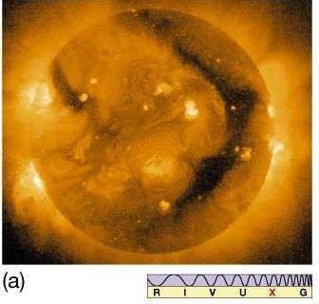
Coronal Holes

Slide 44
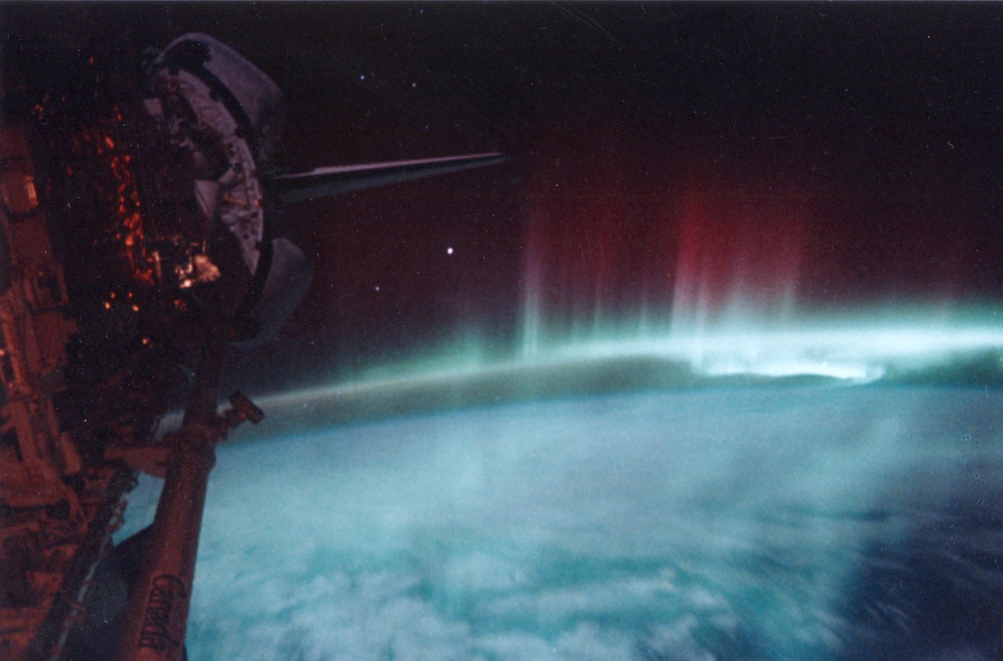
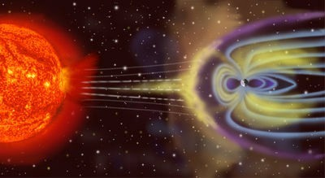
Solar Wind
⦿
The solar wind is a stream of charged particles ejected from the upper atmosphere of the sun. It mostly consists of electrons and protons.
The stream of particles varies in temperature and speed over time.
These particles can escape the sun's gravity because of their high kinetic energy and the high temperature of the corona.
⦿
⦿

Slide 45
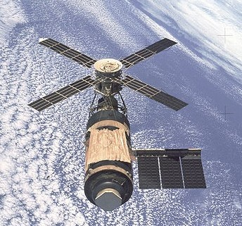
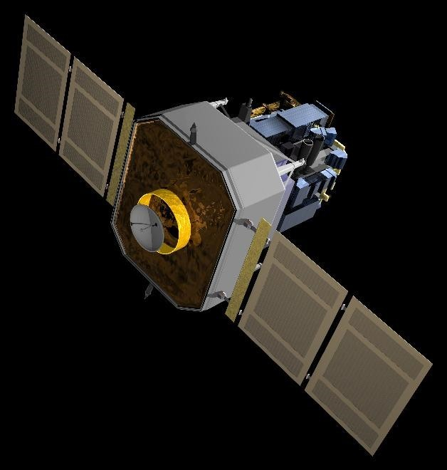
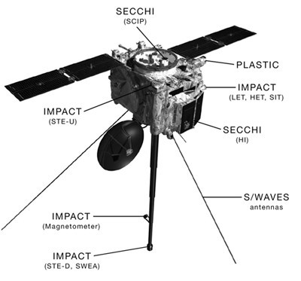
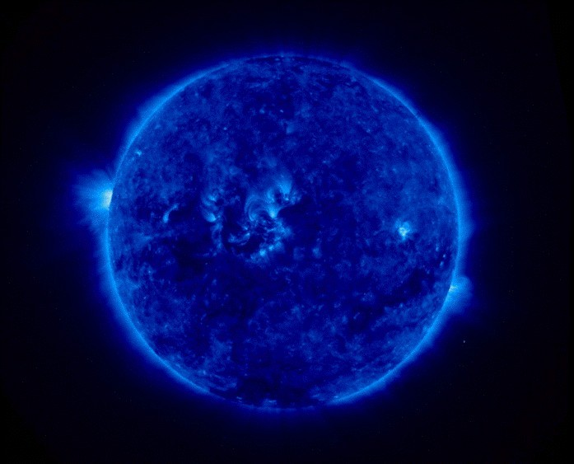
Exploring the Sun
⦿ Skylab
⦿ SOHO – SOlar and Heliospheric Observatory
⦿ STEREO - Solar TErrestrial RElations Observatory

Slide 46
Summary
Main interior regions of Sun: core, radiation zone, convection zone, photosphere, chromosphere, transition region, corona, solar wind
Energy comes from nuclear fusion; produces neutrinos along with energy
Standard solar model is based on hydrostatic equilibrium of Sun
Study of solar oscillations leads to information about interior

Slide 47
Summary
Absorption lines in spectrum tell composition and temperature
Sunspots associated with intense magnetism
Number of sunspots varies in an 11-year cycle
Large solar ejection events: prominences, flares, and coronal ejections

